Slide 1
Chapter 9
IP Routing

Slide 2
Routing Basics
If a network isn’t directly connected to the router, the router must use one of two ways to learn how to get to it.
Static Routes
Routes YOU put in
Dynamic Routes
Routes that are discovered
Networks route based on information in routing table
Switches route based on ARP Table
Notes:
Routers build routing tables that describes how to find remote networks
Static routing: manually adding in the routes by which your router needs to send packets. Admin’s job to update it
Dynamic routing: A protocol on one router communicates w/ the same protocol running on a neighbor router. Neighboring routers update automatically when changes occur
Routers are really good at making updates when networks change or a certain route is out, the updates are called convergence

Slide 3
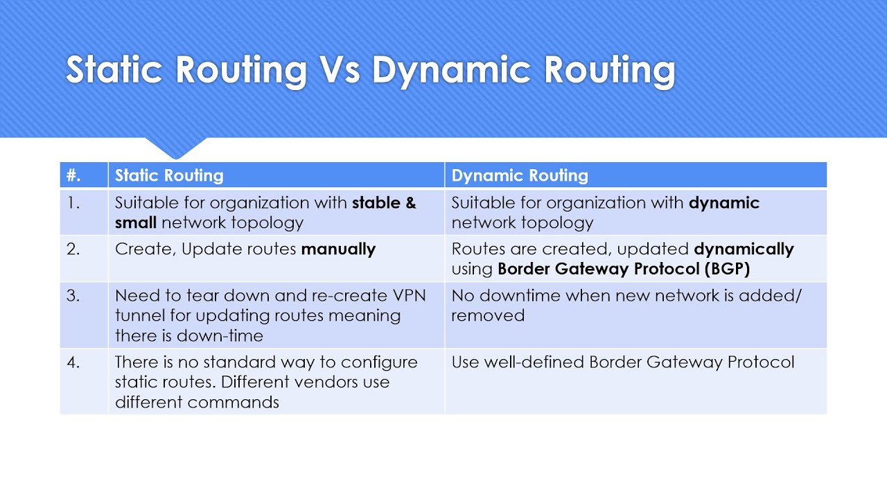

Slide 4
Dynamic Routing
Distance Vector – Hops
Route Initialization Protocol (RIP)
Link State
Open Shortest Path First (OSPF)
Notes:
Distance vector calculations: determines the best route for packets based on distance/number of hops
Link-state calculations: Status of the network determines the route; uses the route with the fastest route based on bandwidth; may have more hops, but still ends up being faster

Slide 5
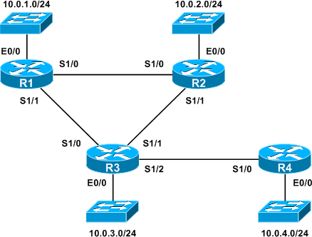
Notes:
Link-state calculations: has each individual router figure out the route to each node on the network, based on all those routes, link-state put together a table featuring the best routes to take

Slide 6
Dynamic Routing
Hybrid Routing Protocols – Mix of link-state and distance vector
Border Gateway Protocol (BGP)
Notes:
BGP- determines the route based on the number of hops, network policies, and rules you can configure on the protocol itself

